Slide 1
Computer Networks
CS 430

Slide 2
Network Layer

Slide 3
Objectives
Forwarding and Routing
Internet Protocol
IPv4
IPv6
ICMP
Routing algorithms
link state
distance vector
hierarchical routing
BGP

Slide 4

















Network Layer
application
transport
network
data link
physical
Host-to-host
Sender encapsulates segments into packets
Receiver extracts segments to transport layer
Network layer protocols in every host, router
Router examines header fields in all IP datagrams passing through it
network
data link
physical
network
data link
physical
network
data link
physical
network
data link
physical
network
data link
physical
network
data link
physical
network
data link
physical
network
data link
physical
network
data link
physical
application
transport
network
data link
physical
network
data link
physical
network
data link
physical

Slide 5
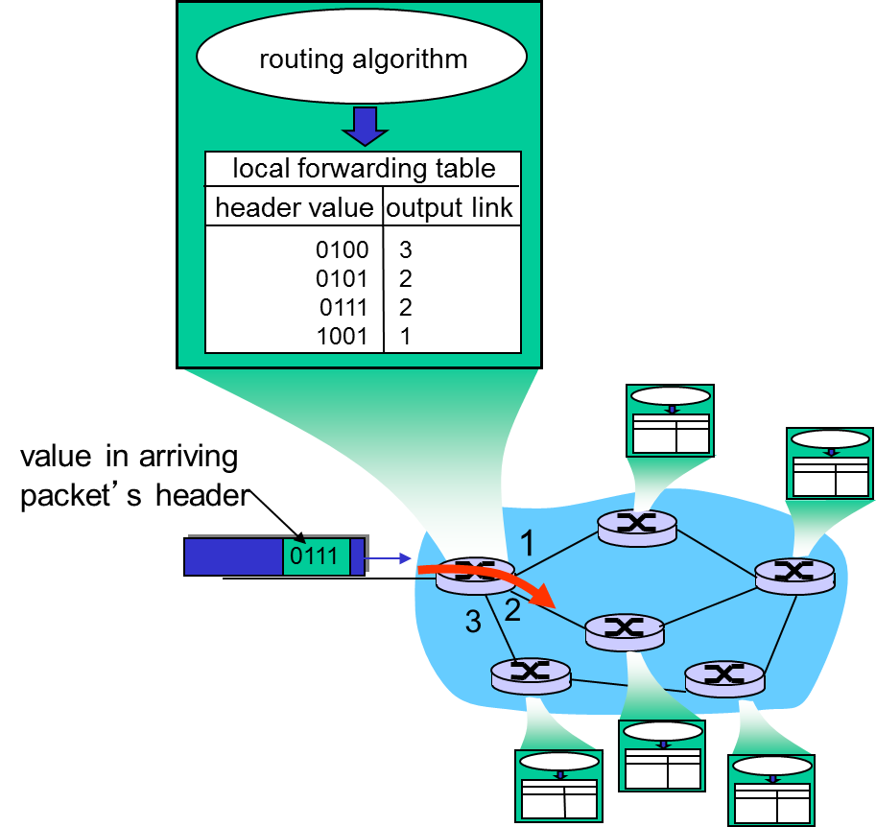
Network Layer Functions
Forwarding
Move packets within a router
Routing
Determine a route taken by packets from source to destination
Routing algorithms

Slide 6
Network Layer Planes
Data Plane
Control Plane
Local, per-router function
Determines how datagram arriving on router input port is forwarded to router output port
Forwarding function
Network-wide logic
Determines how datagram is routed among routers along end-end path from source host to destination host
Two control-plane approaches
traditional routing algorithms: implemented in routers
software-defined networking (SDN): implemented in (remote) servers

Slide 7
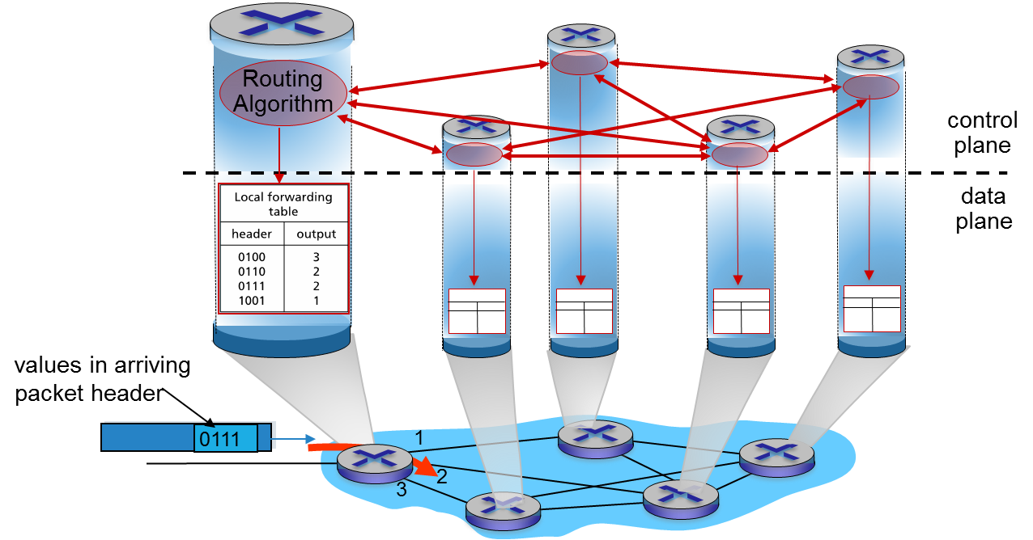
Per-router Control Plane

Slide 8
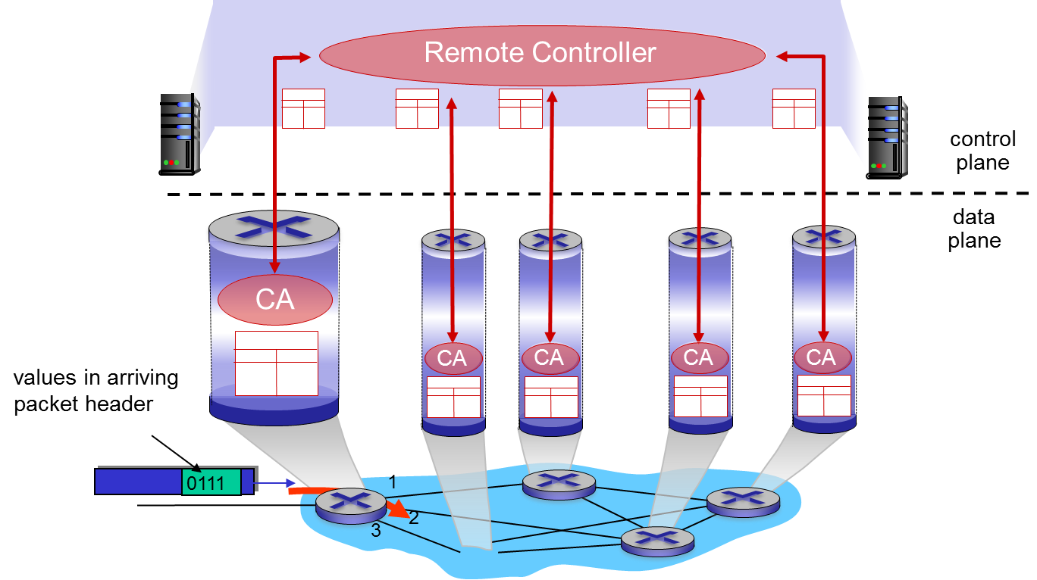
Logically Centralized Control Plane

Slide 9
Connection Setup
What network layer protocol(s) do you know?
IP, IPv6
There are others too!
ATM, frame relay, X.25
Virtual connection established
Like TCP
Hosts and routers are involved
Circuit switching vs packet switching
Host-to-host
Mutually exclusive
Network core
Internet
Best effort
No guarantees
No congestion control

Slide 10
Network Service Model
Individual packets
Guaranteed delivery
Guaranteed delay
Packet flow
In-order delivery
Guaranteed minimum bandwidth
Max jitter
Security

Slide 11

Packet (Datagram) Networks
No call setup at network layer
Routers: no state about end-to-end connections
no network-level concept of “connection”
Packets forwarded using destination host address
application
transport
network
data link
physical
application
transport
network
data link
physical
1. send datagrams
2. receive datagrams

Slide 12
Routers

Slide 13
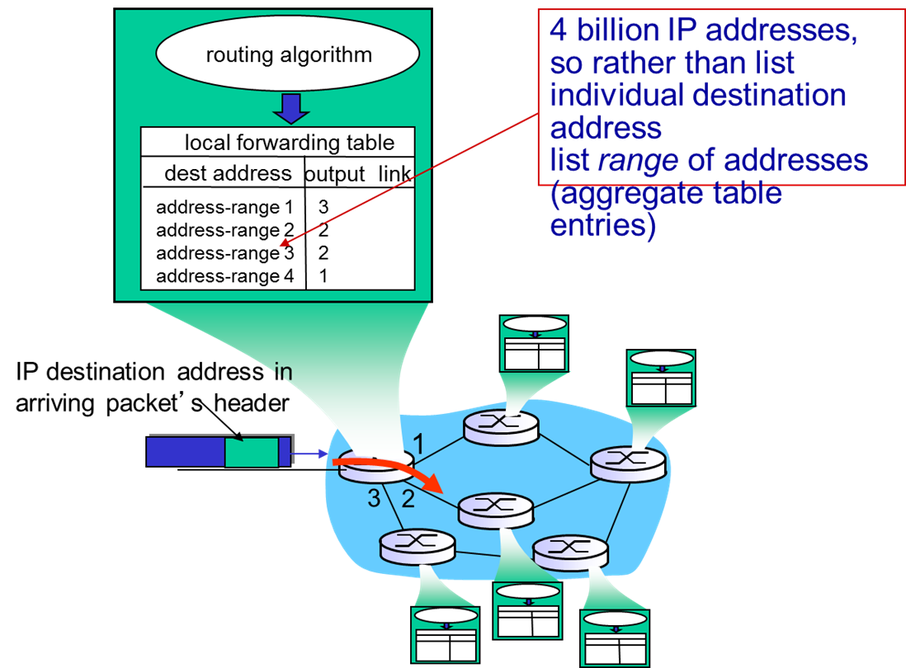
Packet Forwarding

Slide 14
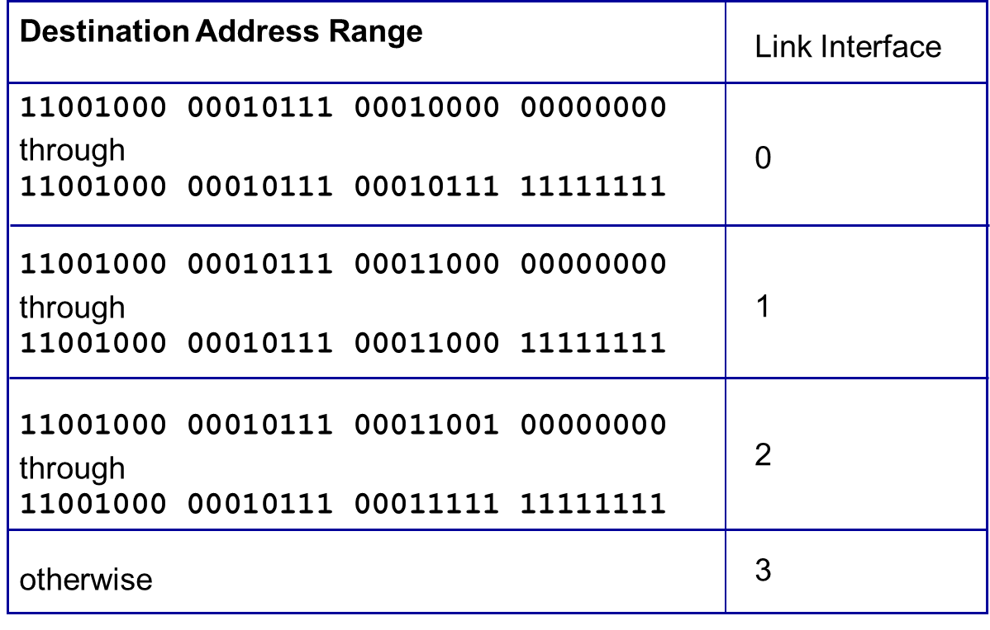
Packet Forwarding Table

Slide 15
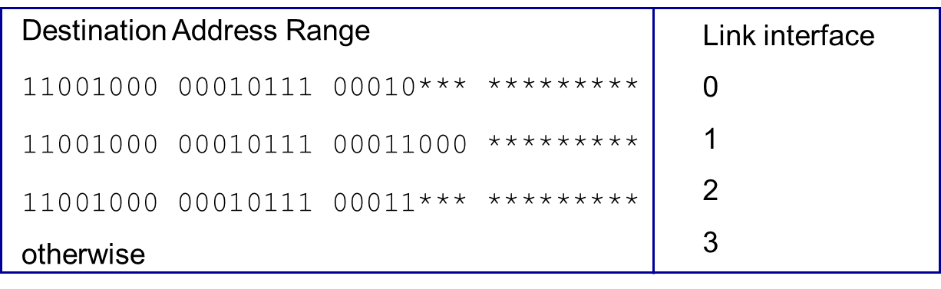
Longest Prefix Matching
Destination 1
11001000 00010111 00010110 10100001
Destination 2
11001000 00010111 00011000 10101010

Slide 16
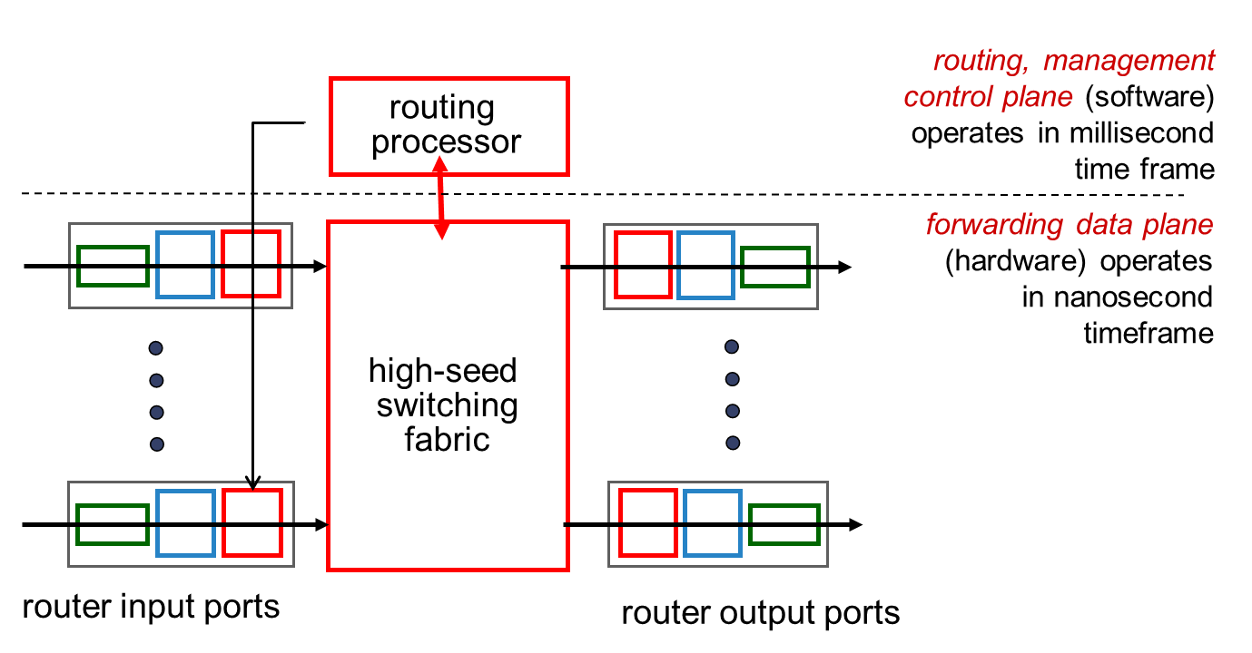
Router Architecture Overview

Slide 17
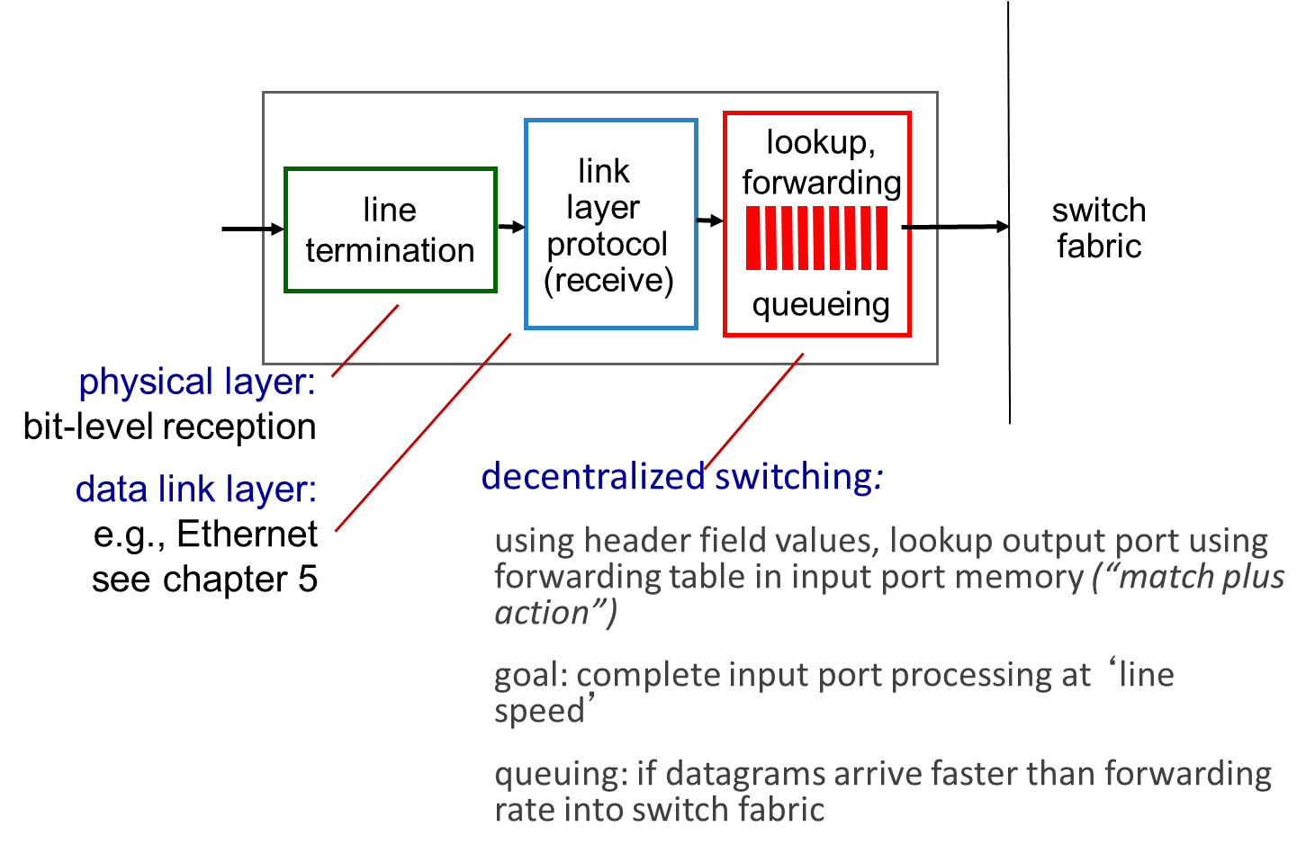
Input Port Functions

Slide 18
Switching Fabrics
transfer packet from input buffer to appropriate output buffer
switching rate: rate at which packets can be transfer from inputs to outputs
often measured as multiple of input/output line rate
N inputs: switching rate N times line rate desirable
three types of switching fabrics
memory
memory
bus
crossbar

Slide 19
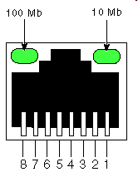
Switching via Memory
First generation routers
traditional computers with switching under direct control of CPU
packet copied to system’s memory
speed limited by memory bandwidth
input
port
(e.g.,
Ethernet)
output
port
(e.g.,
Ethernet)
memory
system bus

Slide 20
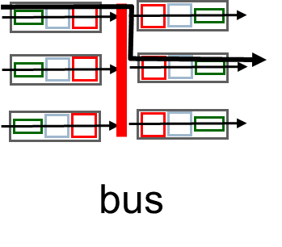
Switching via a Bus
Shared bus
Bus contention
switching speed limited by bus bandwidth
32 Gbps bus, Cisco 5600: sufficient speed for access and enterprise routers

Slide 21
Switching via Interconnection Network
Overcome bus bandwidth limitations
banyan networks, crossbar, other interconnection nets initially developed to connect processors in multiprocessor
Advanced design
fragmenting datagram into fixed length cells, switch cells through the fabric.
Cisco 12000: switches 60 Gbps through the interconnection network
crossbar

Slide 22
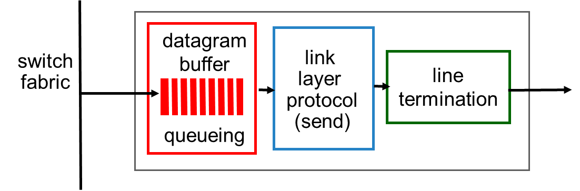
Output Ports
buffering required when datagrams arrive from fabric faster than the transmission rate
scheduling discipline chooses among queued datagrams for transmission

Slide 23
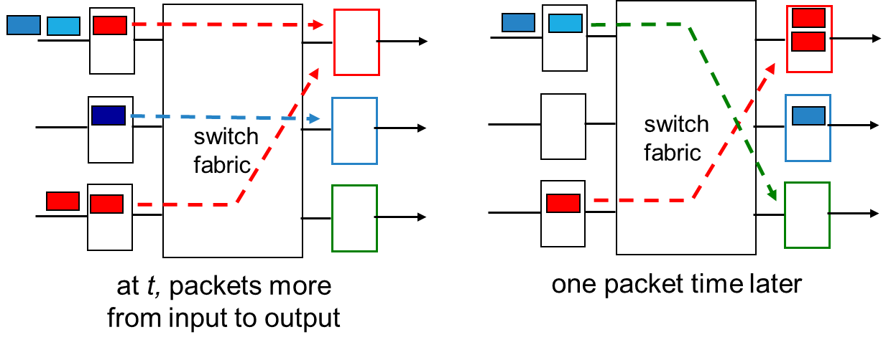
Output Port Queuing
buffering when arrival rate via switch exceeds output line speed
queueing (delay) and loss due to output port buffer overflow!

Slide 24
How Much Buffering?
RFC 3439 rule of thumb: average buffering equal to “typical” RTT (say 250 msec) times link capacity C
e.g., C = 10 Gpbs link: 2.5 Gbit buffer
recent recommendation: with N flows, buffering equal to
.
RTT C
N

Slide 25
Input Port Queuing
fabric slower than input ports combined -> queueing may occur at input queues
queueing delay and loss due to input buffer overflow!
Head-of-the-Line (HOL) blocking: queued datagram at front of queue prevents others in queue from moving forward
switch
fabric
switch
fabric
output port contention:
only one red datagram can be transferred. lower red packet is blocked
one packet time later: green packet experiences HOL blocking

Slide 26
Thank You!

